Slide 1
CTO Application Lifecycle Management
RTC Role Based Training for Developers
Version: | 1.0
Document Classification | Internal
Effective Date: | 9/12/2014
Unit | CTO
Library: | ALM/RTC
Author | Amitabha Nath
Reviewer | Andy Wilson & John Coulter
Document Owner: | Michael McBride

Slide 2
Contents
Eclipse Installations
P2 Plugin installation for existing eclipse user.
Eclipse new installation & CMP
Logging in to Rational team Concert-
Accept team invitations
Create Repository connections -
Join Projects .
Source code management
Create Repository Workspace
Load/unload Repository Workspace
share/import Projects into Repo workspace.
View Repository Files in Stream
Check-in/deliver changes
History & compare

Slide 3
Contents cont..
Work item management
Create WorkItem
Browse Workitem.
Change status .
Build Management-
Request personal & team build .
Browse Build logs
Support Details
Support Details

Slide 4
Eclipse Installations

Slide 5
Installations
P2 Plugin(RTC 4.xx) installation for existing eclipse user.
Eclipse IDE (RTC 4.x plug-ins require Eclipse 3.7)
Go to "Help -> Install New Software.."
Click "Add.."
Name: RTC
Site for RTC 406 http://cateeclipseplugins.nam.nsroot.net:20211/xcweb/catesite/rtc/4.0.6w
( site for RTC 303 http://hermbs41.nam.nsroot.net:20030/xcweb/catesite/rtc/3.0.1.3/ )
And click "OK.."
Select %RTC Component% [e.g. RTC 3.0.1.3]
Confirm the plug-ins
Rational Team Concert
Select "only 1st dialog box" and Click "Next.."
Review Install Details and Click "Next.."
Eclipse new installation CMP-
The below url takes you to the Market place –https://cmp.nj.ssmb.com/marketplace/control/product/~productId=37612_88087_GLOBAL#
Notes:
RTC server has upgraded to Newer version, there may be new P2 version available from CATE team. Contact Onboarding support team for the new version details. However New RTC server works well with (3.0.1.3) older version.

Slide 6
Logging in to Rational Team Concert
Notes:
You may use any of the eclipse client or web client to login into RTC. Most of the development task needs to be done eclipse Client.

Slide 7
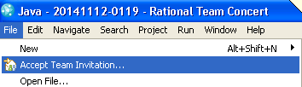
Accept Team Invitations
Once you are added to a project you will receive Team invitation Welcome email from the toolset. Copy the last four line of that email (example below)
teamRepository=https://rtc.nam.nsroot.net/cto/
userId=AN05623s
userName=Amitabha Nath
projectAreaName=31378-ICG Basel III
Open your eclipse & go to file >Accept Team invitation
Notes:
Assumption- Make sure that you are added to Jazz repository & you have been added to the RTC Project as developer. Please contact your manager for adding you in the project area.

Slide 8
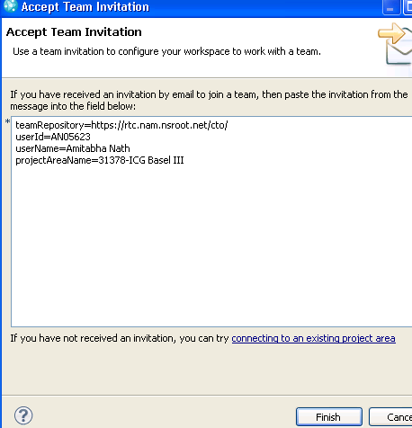
Accept Team invitations
Paste the four lines in the open window & click Finish.
Provide your SSO(UAT/PROD) password. You may reset your SSO password at One Reset

Slide 9
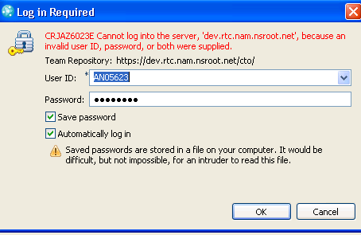
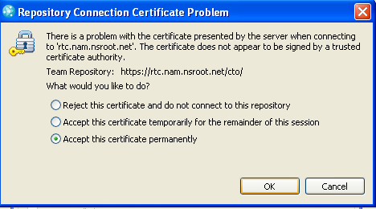
Accept team invitations cont..
Provide your SSO(UAT/PROD) password.
For the first time you may get popup window to accept the certificate. Choose “Accept certificate permanently”
Click Finish

Slide 10
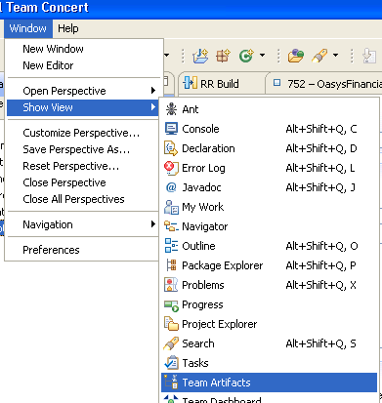

Create Repository Connection
Open your eclipse click Window>Show View>Team Artifacts>
You can switch Perspective in the (Java/Workitem) from the top right corner of your Eclipse.
Notes:
Incase if you have missed the email

Slide 11

Create Repository Connection cont..
Right click the repository Connection
Select New>Jazz repository Connection.
This will pop up another window.
Provide the url details(https://uat.rtc.nam.nsroot.net/cto ) or (https://rtc.nam.nsroot.net/cto)
Provide your SOE id & SSO password (uat or Prod depending on the url)

Slide 12
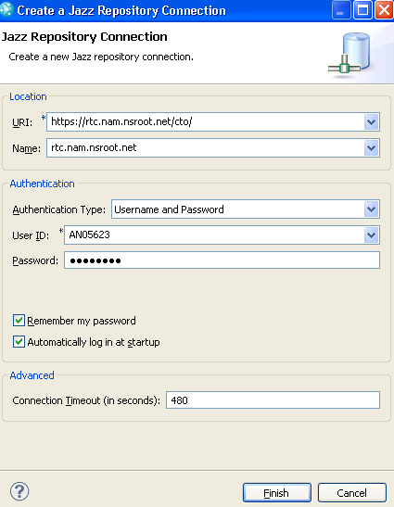
Create Repository Connection cont..
Click Finish.
For the first time you may get popup window to accept the Server certificate. Choose “Accept certificate permanently”

Slide 13
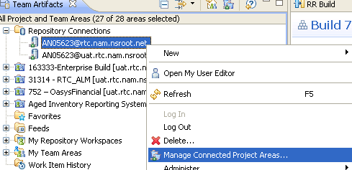
Join Projects
Right click the repository connection created newly
Select “Manage Connected Project Areas..”

Slide 14
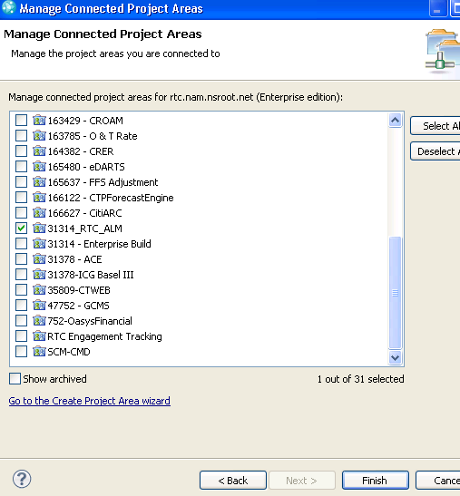
Join Projects cont..
Browse the project you wanted to work, select & mark
Click Finish
Notes:
You must be already part of the project

Slide 15
Source Code Management

Slide 16
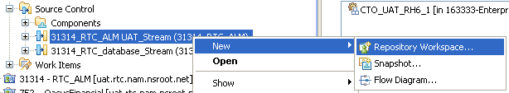
Create Repository Workspace
Expand the Project>Source Control & select the stream you would like to work.
Right click & select New>Repository Workspace
Enter a name <CSI appID><App Name><Release/dev/prod/uat><SOEid>WorkSpace
Eg- 31314_RTC_UAT_AN05623_Workspace

Slide 17
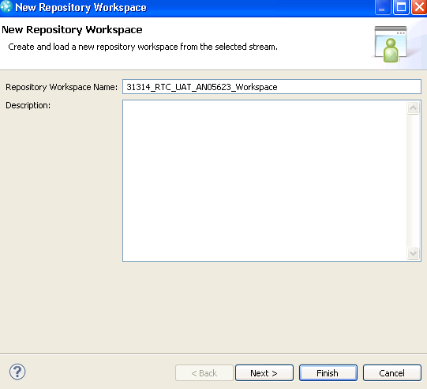
Create Repository Workspace cont…
Click “Next”
Notes:
Please put your SOE id at the end of the name of the WS

Slide 18
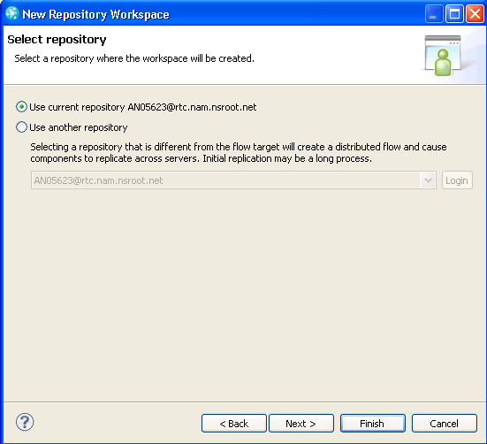
Create Repository Workspace cont…
Donot Select any options here
Click “Next”

Slide 19
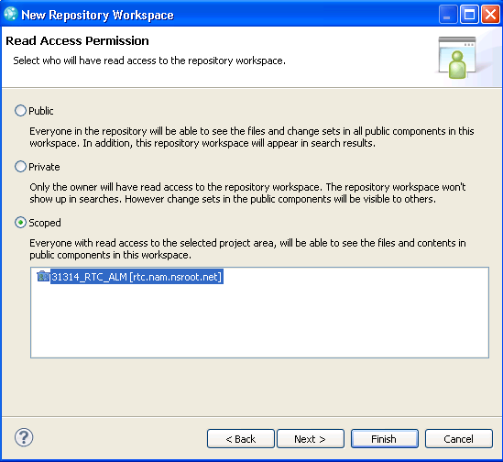
Create Repository Workspace cont…
Select the “Scoped” option
Select the project area & click “Next”
Notes:
Public – Everyone in the Jazz Repository will be able to see Files & changes. Do not select this option
Private – Only you will have read access to the repository workspace. Do not select this as in your absence your team member will not be able to view your saved changes.
Scoped – only team member from the selected Project area will be able to browse your changes. Select this option.

Slide 20
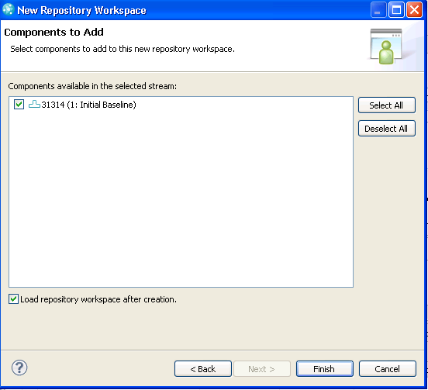
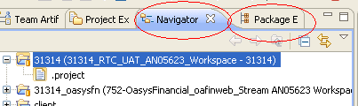
Create Repository Workspace cont…
Select the component & desired baseline(you can change the baseline later)
Mark/unmark the checkbox(Load repo WS after creation). Loading can be done at later.
Click “Finish”
The entire component will get
Loaded in your eclipse Java
Package Explorer view.
Notes:
- Loading will allow everything in repository to load into your Local workspace(Java workspace). Details covered in other chapter later.

Slide 21
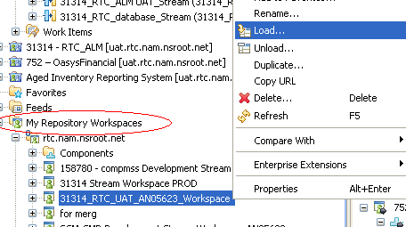
Loading/Unloading existing Repository workspace
Go to My repository Workspace
expand the repository connections & select the existing workspace
Right click the repository workspace & select “Load”

Slide 22
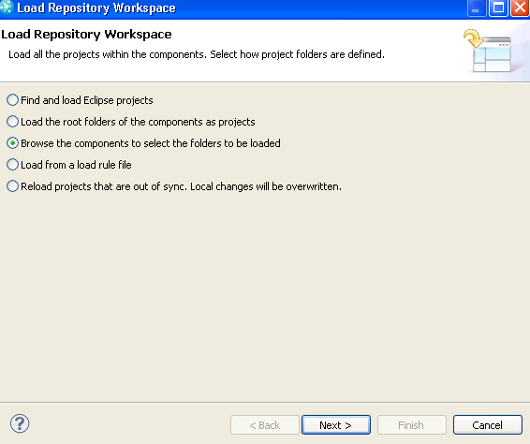
Loading/Unloading cont..
Select option “Browse the compo…”
Click “Next”

Slide 23
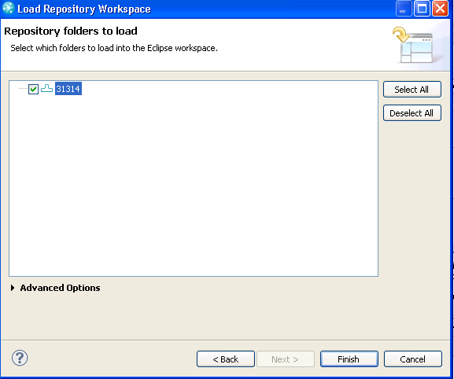

Loading/Unloading cont..
Select the Component
Click “Finish”.
Once completed, you will see as “(loaded)” in the Repo WS.

Slide 24
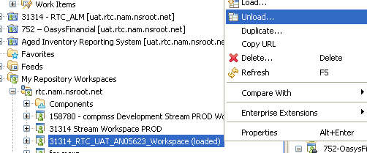
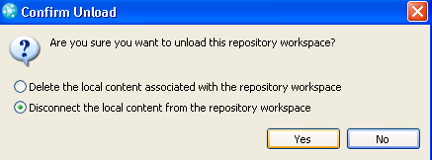
Loading/Unloading cont..
Right Click the repository Connection & select “Unload”
Select “Disconnect the local…”- this will keep the code in Local
Select “delete the local…”- this will disconnect & delete from you local.

Slide 25
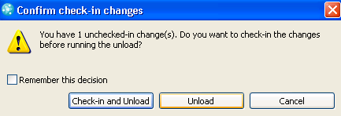
Loading/Unloading cont..
You may get warning there are unchecked-in changes , you may chect it in or ignore at this stage.
Click Unload to complete the unload process.

Slide 26
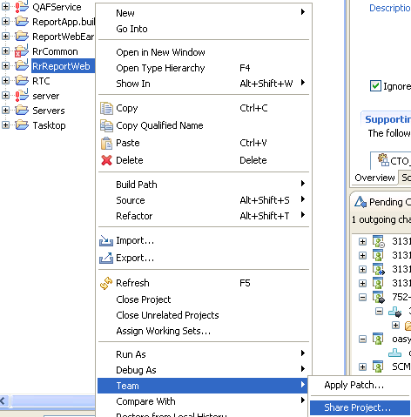
Sharing local Project in My repository Workspace
Go to your Java perspective & open Package Explorer Tab
If you have an existing project that can be shared with My repository Workspaces.

Slide 27
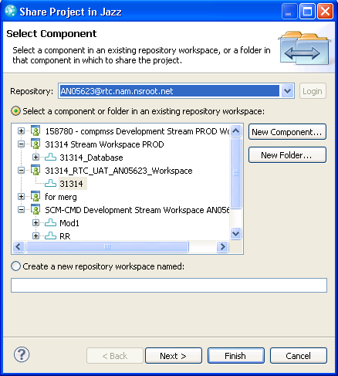
Sharing local Project in My repository Workspace cont..
Make Sure correct Repository connection is selected in the dropdown
You can browse an existing Repo WS
& can create new component or
create new folder inside a existing one.
You may choose to create a new
repo WS.
Select the Component & click “Next”

Slide 28
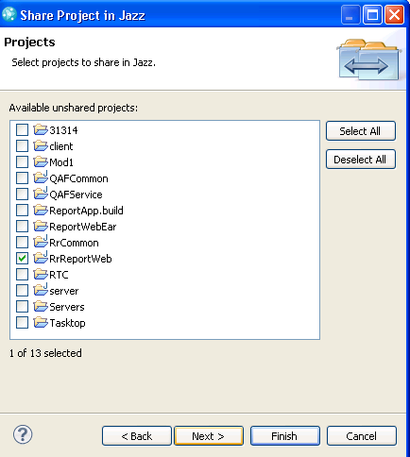
Sharing local Project in My repository Workspace cont..
Select the Project to import
Click “Next”

Slide 29
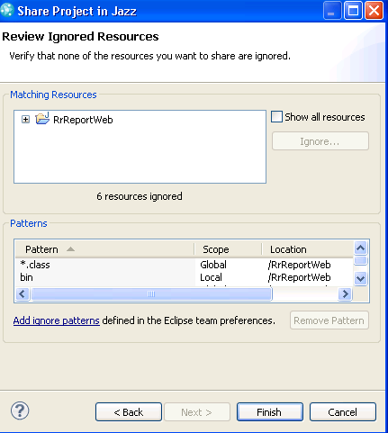
Sharing local Project in My repository Workspace cont..
If this project has unnecessary ( eg-.svn) files ,Add them ignore patterns
Click “Finish”

Slide 30
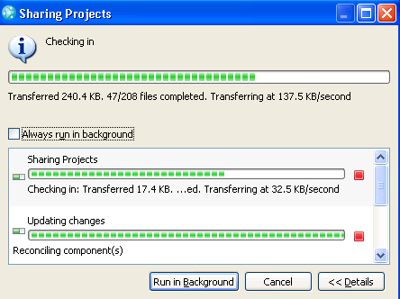
Sharing local Project in My repository Workspace cont..
Sharing a Project means Checking in your projects code in existing Repo WS.
Once the sharing is complete you will be able to see it in your “Pending changes” tab
Notes:
Go to you Your “Jazz administration” perspective & view the pending changes tab

Slide 31
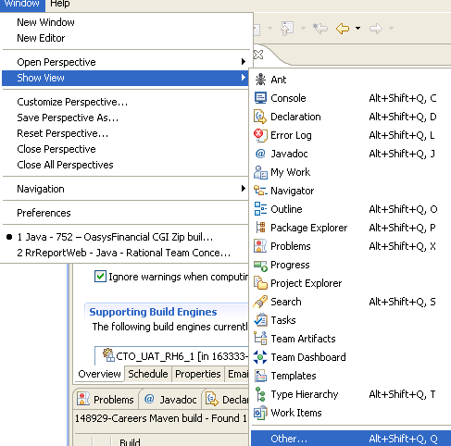
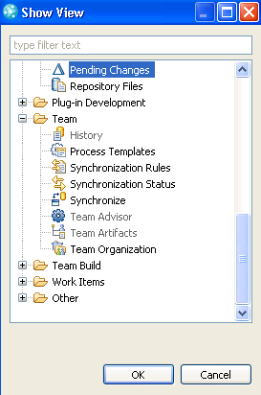
Sharing local Project in My repository Workspace cont..
“Pending changes” tab if not visible in “Jazz Administration” perspective, you can “Window”>”Show View” & it will be listed
If not select “Others” & browse the same & select “OK”.

Slide 32
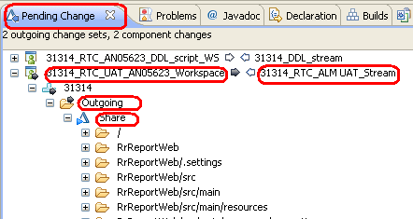
Sharing local Project in My repository Workspace cont..
Pending changes will give you all the Repo OS, wherever there some changes. It may list “Incoming”, “Outgoing” & “Unresolved” folder also.
“Incoming” – represents there are some changes already delivered in the same stream by other team member.
“Outgoing”- represents you changes are checked-in into Repo WS & ready to deliver to the stream.
“Unresolved”- Represents changes made in local but not yet checked-in. If it is checked-in then it will be in “Outgoing” folder.
Notes:
“Incoming” to your Repo WS from the stream will be in listed your pending changes. You may keep it there without accepting it. If you accept it, the new changes will be there in your Repo WS. But if there is changes in your Repo WS for the same piece of code it will automatically open those files in compare editor & allow you to take decision to which to keep.
“Outgoing” – Outgoing folder means- Your changes are saved I server but not delivered in the stream. It is not readily available for the other team member. However they can still browse & load your Repo WS & view the changes you made. You get the option to “Suspend”, “Deliver”, “Discard” & “Complete” option along with other option. We will discuss this on a later stage.
“Unresolved” – This folder has all the changes you saved in local but in the Repo WS. So changes in this folder is not open for evrybody unless you check them in. You should Right click them & Select “Check-in”/”Check-in All” as per your work. You can select multiple & check them in.

Slide 33
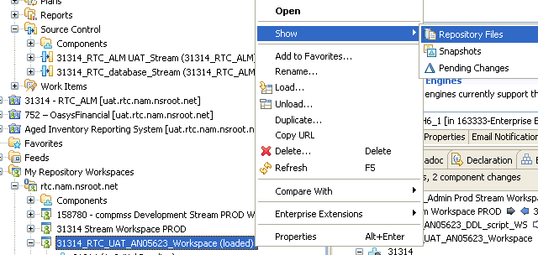
Sharing local Project in My repository Workspace cont..
This changes are not available in the stream. You should deliver them.
To “Deliver” a piece of code You should associate it with a work item.
Notes:
At this stage you may compare your Stream & workspace repository Files, by Right click & show repository files.
To “Deliver” anything from the outgoing folder, you need to associate a workitem everytime. Creating & associating workitems are described in WIM work item Management chapter. Assuming that you already have a existing workitem & will associate the same at delivery. RTC is Change control management(CCM) tool & needs “Task” (Work Item) association at “Deliver”

Slide 34
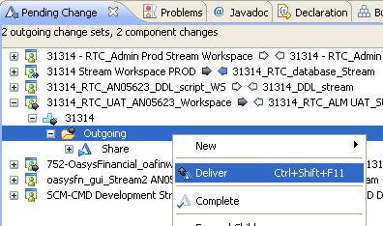
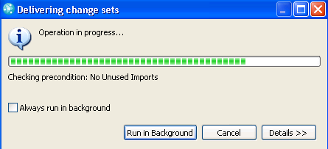
Sharing local Project in My repository Workspace cont..
Right click the “Outgoing” Folder & select “Deliver”.
Once completed, It will not be there in the “Outgoing” folder for the Repo WS.
Notes:
It may throw you error, if there is any unused imports. In case of error it will also tell you the solution to clean those unused import.
Each delivery should be associated with workitem except the initial Sharing Projects. We will discuss this in Workitem Management part.

Slide 35
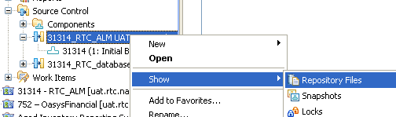
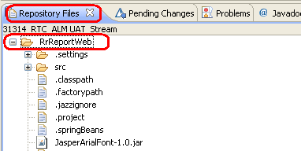
Viewing Repository Files in Stream
You may also cross check the same at Stream level by doing Show repository files.
Right click the Stream & select “Show”> “Repository Files”.

Slide 36
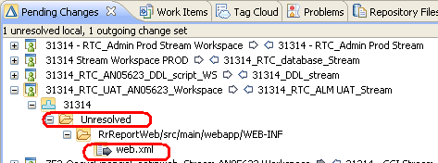
Check-in & Deliver
Load the Repository Workspace. & go to Java Perspectives.
Do some changes in the your Code base. & save the same
Go to your RTC perspective & open “Pending changes” tab
You should be able to see “Unresolved” folder in the particular Repository Workspace.
Notes:
To work on any files, You should load your Repo WS into Local Workspace. Follow the steps in Loading/Unloading existing Repository workspace.
All the changes you made will be vivisble in “Unresolved” Folder.

Slide 37
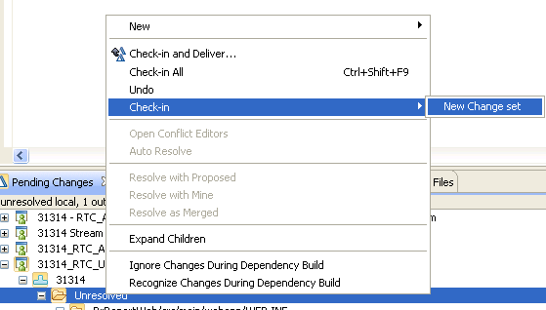
Check-in & Deliver cont..
Right click the “Unresolved” folder “Check-in”> “New Change set”
Once it is “Checked-in” this will be available in the Repo WS.
Notes:
You can browse the unresolved folder & “Checkin”, you may also select some changes from “Unresolved” & check them in selectively. You may also select “Check-in and Deliver”. At the time of deliver you will have to associate Workitem with the “Deliver.”

Slide 38
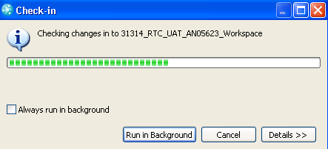
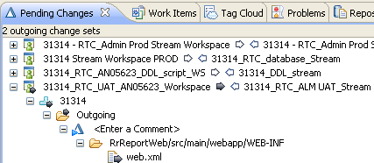
Check-in & Deliver cont..
Once checked in You will see “Outgoing” folder in your “Pending Changes” tab
You may browse & check the changes & decide whether to deliver or not at this level.

Slide 39
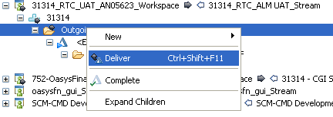
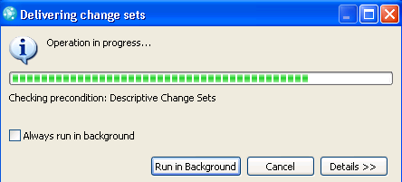
Check-in & Deliver cont..
Right click the “Outgoing” folder & select “Deliver”

Slide 40
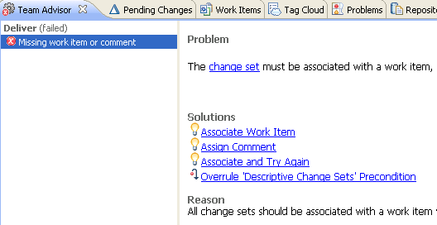
Check-in & Deliver cont..
You will get an error if there is no work item associated with the Deliver.
“Team Advisor” tab will guide you how to resolve the Issue.
Select “Associate Work Item” in the Team advisor Tab.
Notes:
Ideally your team Lead should Create & Assign Task (Workitem) to you for any code change. Being a developer, you can also create Task & assign to yourself to “deliver” your changes.

Slide 41
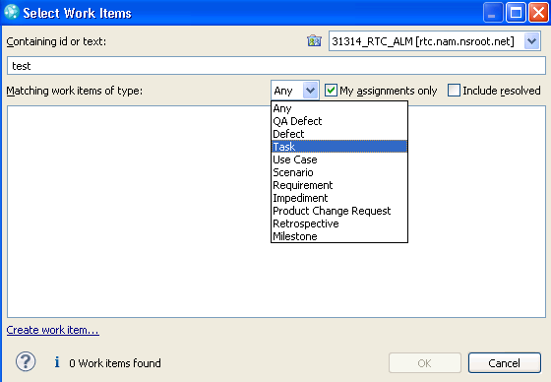
Check-in & Deliver cont..
You should be able to search your task(if any) in this window.
You can also Create work item from this window by selecting “create work item” link at bottom of the window.
Click the link.

Slide 42
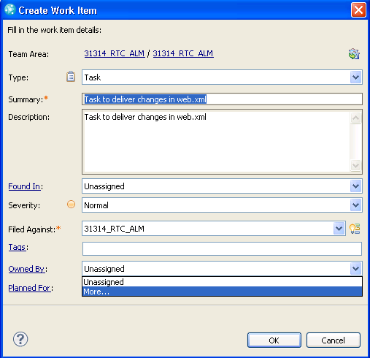
Check-in & Deliver cont..
In the create work item window , select the type as “Task”
“Filed Against” mandatory
“Owned By” select your name If visible else click more..

Slide 43
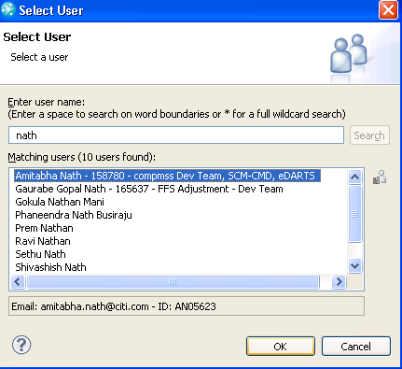
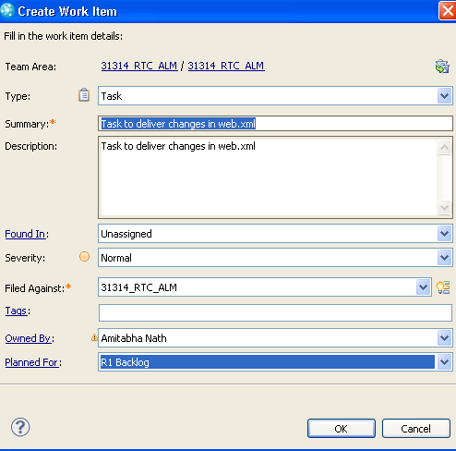
Check-in & Deliver cont..
In the select User window give your last name & “Search”
Select your name Click “OK”
Click “OK” in the Create work Item window also.

Slide 44
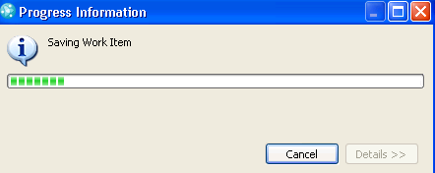

Check-in & Deliver cont..
Once the work item is saved you should get an email notification
& you should be able to see (quick Fix Applied) in the Team Advisor tab.
You will also be able to view the workitem in Work item Querry or in the work item history.

Slide 45
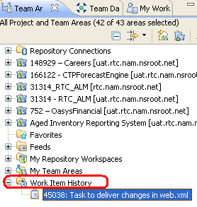
Check-in & Deliver cont..
In the Team artifacts tab at bottom you will workitem History, you will see the newly created workitem.
Double click the workitem to open it in middle pan of your eclipse.

Slide 46
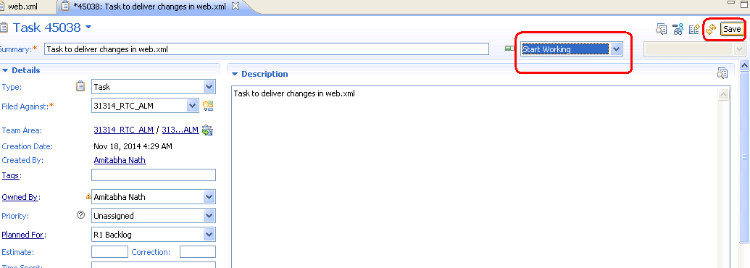
Check-in & Deliver cont..
Select “Start working” in the states of the task.
Save the task. Once saved the sates will change to “In progress”

Slide 47
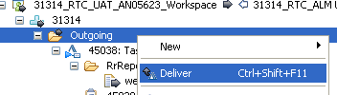
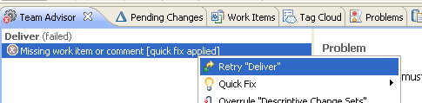
Check-in & Deliver cont..
Go back to your Pending changes select “Outgoing” folder & “Deliver” now
You may also go to “Team Advisor” tab & “Retry Deliver”
Once deliver completed You wil be able to see the changes in Steam/component level.
Notes:
All other user who ever working for the same Stream(Release) will have “Incoming” folder created in their Repository WorkSpace now for the changes you made.

Slide 48
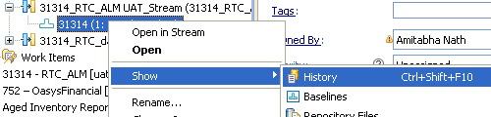

History & Compare
You can select the particular component in the stream right click
Select “Show” & “History” to see who has done changes till now.
This will open the “History” tab, will list down all the changes/records/deliver made in the component.
Notes:
This can be done at Repo WS level

Slide 49


History & Compare cont..
You may double click any records in “History” to check what the changes been delivered to the stream by other team members.
You may also compare the changes with other baseline/Repo WS/current baseline in Stream or Workspace level.

Slide 50

History & Compare cont..
Select “Current Baseline”
In the “Change Explorer” tab you should be able to view the comparison.

Slide 51


Create Baseline
Create baseline by selecting the Repo WS & Component
Select the Component, right Click>New>Baseline..
Update name of the Baseline & Description & select “OK”
Notes:
You may create baseline once project reaches certain milestone. There could be other situation where you may need to create baseline. As an example after a successful build You can baseline your project.

Slide 52


Create Baseline cont..
Once the baseline is created it will be in “pending Changes” tab in outgoing Folder.
Right Click the outgoing Folder deliver the changes.
You also need to associate work item for the delivery.
Once deliver is completed you will be able to see the new baseline in Stream/component area.

Slide 53
Work Item Management
There are 2 kind of work item “Planning WI” & “Executable WI”
Task/Defects are the only Executable Workitem in RTC projects.
Requirement/change request/User story/Use case etc are the Planning workitem.
You need to associate Task with each “Deliver” you make in codebase.
For one functionality change you can have multiple tasks assigned to several user.
For different code changes/functionality use different tasks.
Notes:
Workitems(tasks) cane be linked as parent/child/block etc with other tasks in the link tab.

Slide 54


Create Task
Select “Work Item” in you “Team artifact” tab
Right click “New”>“Work Item”.
Select “Task” & click Finish.

Slide 55

Create Task cont..
Task will be
Notes:
Initial Screen will look like the below. It will not have any task id as the task is not created yet.

Slide 56


Create Task cont..
Select Type as “Task”
“Summary” – mandatory -
“Filed Against” mandatory – Select any( if not specified by Your lead)
Give other details(Priority, Estimate, Due date)
Write “Description”
“Save” in the top right corner

Slide 57
Create Task cont..
“Owned By” select your name if visible else click more..
In the select User window give your last name & “Search”
Select your name Click “OK”
Click “OK” in the Create work Item window also.

Slide 58

Create Task cont..
Give all the possible details & click “Save” the task.
The Task will be now in “New” State.
You may change the state to “Start working” & save the task again.
Notes:
If you do any changes in the task you will have to save it every time. Task will automatically record all the changes you make in History tab.
You may also link some of other workitem in the Link tab. You will get an email for the new task created.

Slide 59



Create Task cont..
You may add “Subscriber” & add related work item for this task in the link Tab.
Click “Add” near the “Subscriber” & browse the User. Select & clik “OK”
“Save” the Task, new Subscriber is added in the task.(figure- bottom left)
Notes:
Subscriber generally gets notified during any state transition. Eg- you may add subscriber your team laead that when you complete this task S/He also gets notified along with you. Subscriber can be added from anybody inside &outside the project.
You also may add a parent/child workitem with this tasks. Parent child relation Parent workitem can not be close unless the child WIs are closed.

Slide 60

Create Task cont..
Click the “Add” button near the Link.
Select the same
Notes:
Eg_ Set Parent

Slide 61


Create Task cont..
Select the parent task from the existing Task List & select OK
You may also create new WI from this window.
You will see link to other task once the relation created.

Slide 62


Browse WorkItem
Expand “Work Items”> “Shared Queries” > “Predefined” >”Open Assigned to me” (figure-left)
Double click the Query “Open Assigned to me” & all the task assigned to you will be listed (figure-right)

Slide 63


Change WorkItem Status
Double click the Workitem from the Query. Task will open in a new window.
Click the Drop Down on the Right side of “Summary” & change the staes to desired States.
Save the Workitem.

Slide 64
Build Management

Slide 65

Request Personal & Team build
In the Workitem view/perspective, Team Artifact Tab, Expand Build ‘+’ sign.
You will be able to browse the build definition created by your Project admin.
If no build definition listed contact your project admin.
Select one Build definition & right click
Select “Request Build”

Slide 66

Request Personal & Team build cont..
In the request Build Window click “Build Option”
If there is no Build engine created for your Project you may brose the build engine provided by Enterprise build team.
Check Personal build if you want to build in Repository Workspace.
For Team Build You may select the stream. ( not advisable) you contact your project administrator for the same. These needs to be done after changing options in the “Build Definition” Properties.

Slide 67

Request Personal & Team build cont..
In Select build engine tab select Show all build Engines
Select any of the Build engine provided by “163333-Enterprise build” Team.
Click “OK”
If project administrator created Project Build you can view in “show build engines in project area” option. Confirm with Project administrator before selecting the proper Build engine.

Slide 68


Request Personal & Team build cont..
Click “Personal Build”.
Click “Browse” near Repository Workspace & browse workspace where the build should run.

Slide 69

Request Personal & Team build cont..
You may exclude some components from the “Browse” near “component Load Rules”.
Click “Submit”

Slide 70


Browse Build logs.
Once Submitted it will listed in the build result view Window.
You may also browse the Result by right click the build definition select “Show Results”

Slide 71

Browse Build logs cont..
Once your Build is completed you may get email notification as per the build definition. You will also be able to view the notification in the Eclipse client.
To view the Build Results double click any build from the build lists.

Slide 72

Browse Build logs cont..
Build result will have different tab “Overview”, “Activities”, “Downloads”, “Logs” etc once opened.
You may view all the attributes for a detail analysis.

Slide 73

Browse Build logs cont..
In “Downloads” tab, you will be able to se the packages Created.
The packages can be downloaded & saved locally by “Save As” button.
Link can be crated with the package for further use. By “Add Link” button.

Slide 74

Browse Build logs cont..
Click the “Logs” tab for details build steps.
Click “Full Build Log” & select “Open”.

Slide 75

Browse Build logs cont..
The Steps performed in build will be in detail visible in a new window .

Slide 76
Support Details
Support Email: *GT Global ALM Support
Incidents Service Now: CTO GL PA INCIDENT-MW ALM
ALM Onboarding team – *CTO GLOBAL ALM Onboarding Support
CMP Request to Add User in Jazz https://catecollaboration.citigroup.net/domains/deveng/ALMTA/RTC/Pages/RTC_Create_User_ID.aspx
CMP Request to add users in bulk - https://cmp.nj.ssmb.com/marketplace/control/product/~productId=47246_57365_GLOBAL#
Install RTC Plug-in in existing Eclipse - http://hermbs41.nam.nsroot.net:20030/xcweb/catesite/rtc/3.0.1.3/
CMP Request for Eclipse IDE - https://cmp.nj.ssmb.com/marketplace/control/product/~productId=37612_88087_GLOBAL#
Ask Experts/join RTC community(internal) - https://collaborate.citi.net/groups/alm-ibm-rtcram
Ask IBM & Jazz Community (external)- https://jazz.net/forum
RTC wiki page- Wiki
RTC URLs to login UAT env - https://uat.rtc.nam.nsroot.net/cto/web
Prod env- https://rtc.nam.nsroot.net/cto/web

